Slide 1






DESCRIPTIVE STATISTICS
AZEEZ AREGBESOLA
BEYOND THE NUMBERS

Slide 2




DESCRIPTIVE STATISTICS
BEFORE ANALYZING DATA, WE NEED TO UNDERSTAND ITS BASIC PROPERTIES.
DESCRIPTIVE STATISTICS SUMMARIZES DATASETS, HELPING US IDENTIFY TRENDS, PATTERNS, AND ANOMALIES.
THIS POST WILL COVER:
Concept Introduction – What is descriptive statistics, and why is it important?
Real-World Example – A fresh dataset showing how descriptive statistics summarize data.
Simplified R Code – Step-by-step implementation.
Visualization – Boxplots and histograms to showcase key statistics.
Key Takeaways – Summary.
AZEEZ AREGBESOLA
BEYOND THE NUMBERS

Slide 3



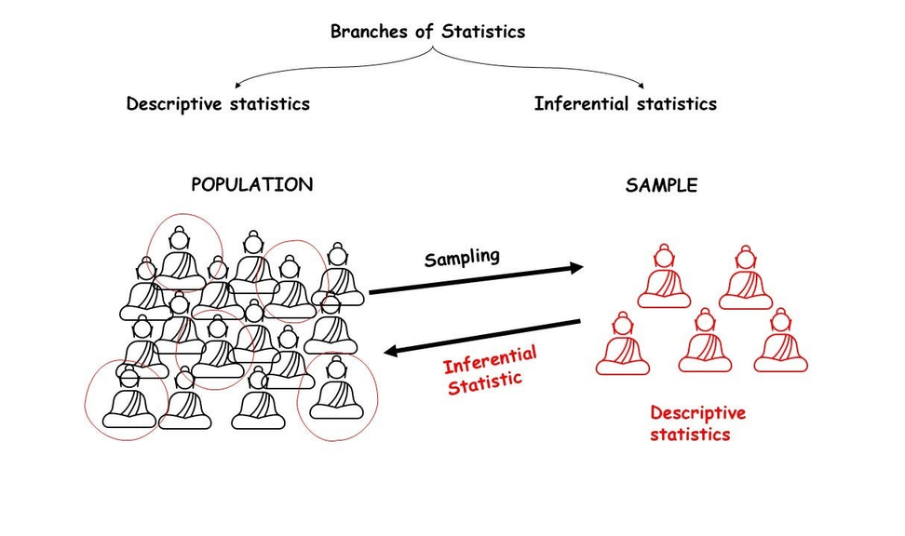
CONCEPT INTRODUCTION
📊 DESCRIPTIVE STATISTICS: MAKING SENSE OF DATA!
Why does this matter?
Businesses track average customer spend 📈
Health researchers analyze blood pressure distributions 🏥
Marketers compare click-through rates 🔍
AZEEZ AREGBESOLA
BEYOND THE NUMBERS

Slide 4


REAL-WORLD EXAMPLE
IMAGINE YOU’RE ANALYZING MONTHLY SALARIES OF EMPLOYEES IN A TECH COMPANY.
We want to summarize the dataset using:
✅ Measures of Central Tendency: Mean, Median, Mode
✅ Measures of Spread: Variance, Standard Deviation, Range
✅ Shape of Distribution: Skewness, Kurtosis
How do we calculate these?
AZEEZ AREGBESOLA
BEYOND THE NUMBERS

Slide 5

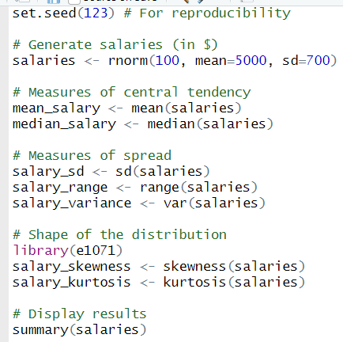


R IMPLEMENTATION
WE’LL GENERATE RANDOM SALARY DATA AND COMPUTE KEY STATISTICS.
AZEEZ AREGBESOLA
BEYOND THE NUMBERS

Slide 6
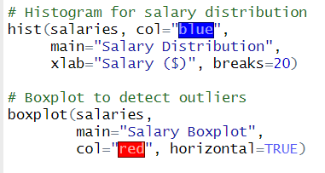
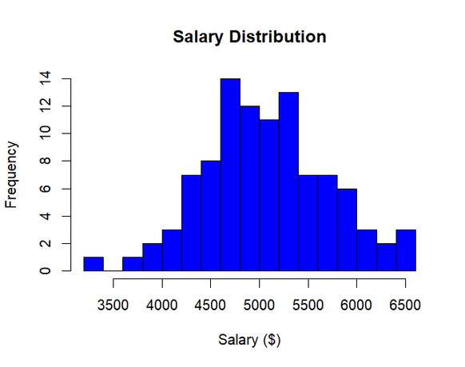
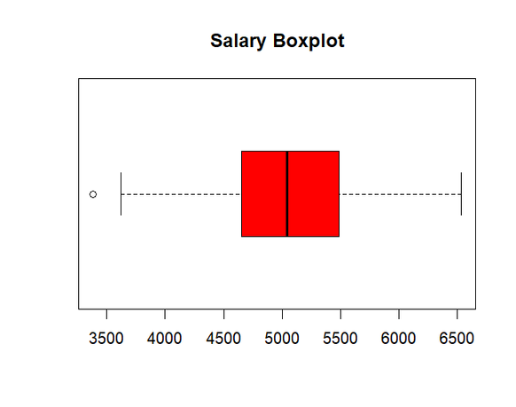
VISUALIZATION
LET’S VISUALIZE THE SALARY DISTRIBUTION:
📌 HISTOGRAMS SHOW THE SPREAD OF DATA.
📌 BOXPLOTS HELP IDENTIFY OUTLIERS AND DATA DISTRIBUTION.
AZEEZ AREGBESOLA
BEYOND THE NUMBERS

Slide 7



KEY TAKEAWAYS
SUMMARY
✅ Descriptive statistics help us summarize complex data into simple insights, guiding smarter decisions.
✅ Metrics like mean, median, and standard deviation reveal patterns, central tendencies, and variability.
✅ Visual tools like histograms and boxplots make it easier to spot trends, outliers, and the shape of data.
💡 How are you currently using descriptive statistics in your projects or business decisions?
AZEEZ AREGBESOLA
BEYOND THE NUMBERS

Slide 8


FROM DATA TO DECISIONS
AZEEZ AREGBESOLA
BEYOND THE NUMBERS

